Slide 2
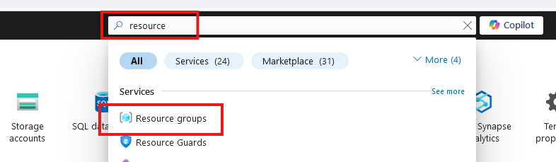
Create Resource Group

Slide 3
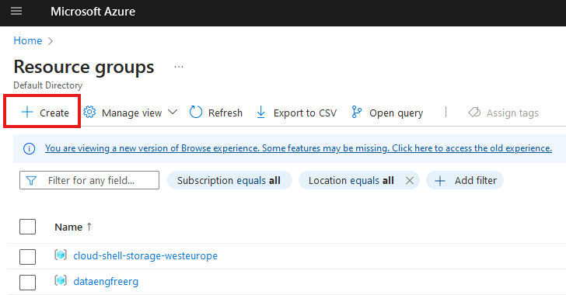
Create Resource Group

Slide 4
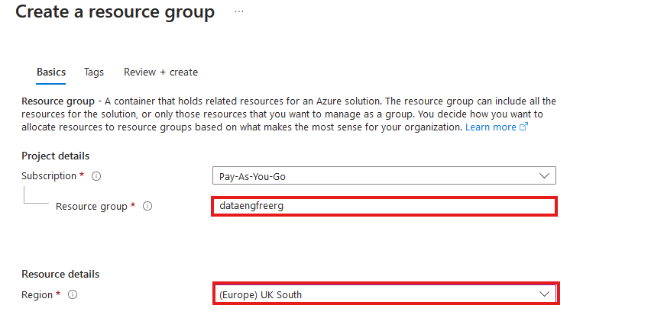
Create Resource Group

Slide 5
VS Code

Slide 6
Azure CLI
Install by following links from: https://learn.microsoft.com/en-us/cli/azure/install-azure-cli
For VSCode:
Azure CLI Tools
Azure Developer CLI
CLI will require extensions for some commands
Automatically downloaded

Slide 7
Azure CLI Demo

Slide 8
Create storage account
Create in same region as RG
Primary service is ADLS Gen 2
Primary workload Big Data Analytics
Performance: Standard
Redundancy: LRS
Add container > RAW directory

Slide 9
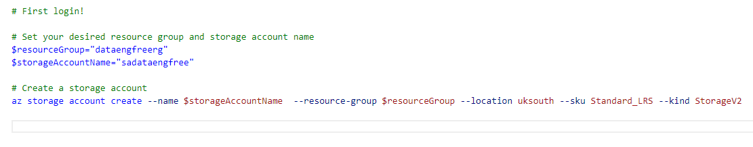
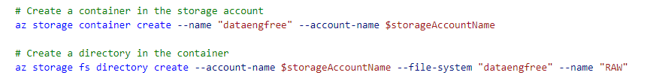
Create storage account

Slide 10
Data & Databases
Concepts to Learn: Data types, databases (SQL and NoSQL), data structures.
Tools/Resources:
Azure SQL Database - free tier available
Cosmos DB: Explore NoSQL databases with a limited free tier on Azure.

Slide 11
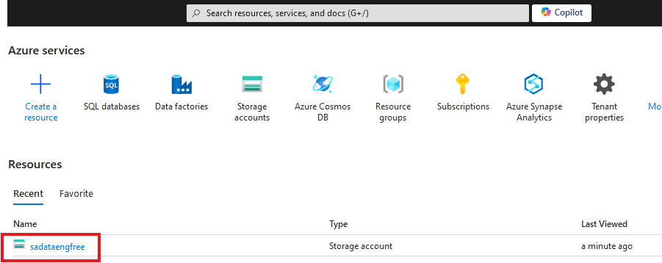

Slide 12
Create Azure Data Factory
Create in same region as RG

Slide 13
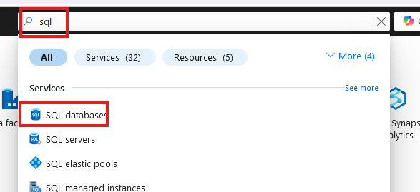
Create SQL database

Slide 14
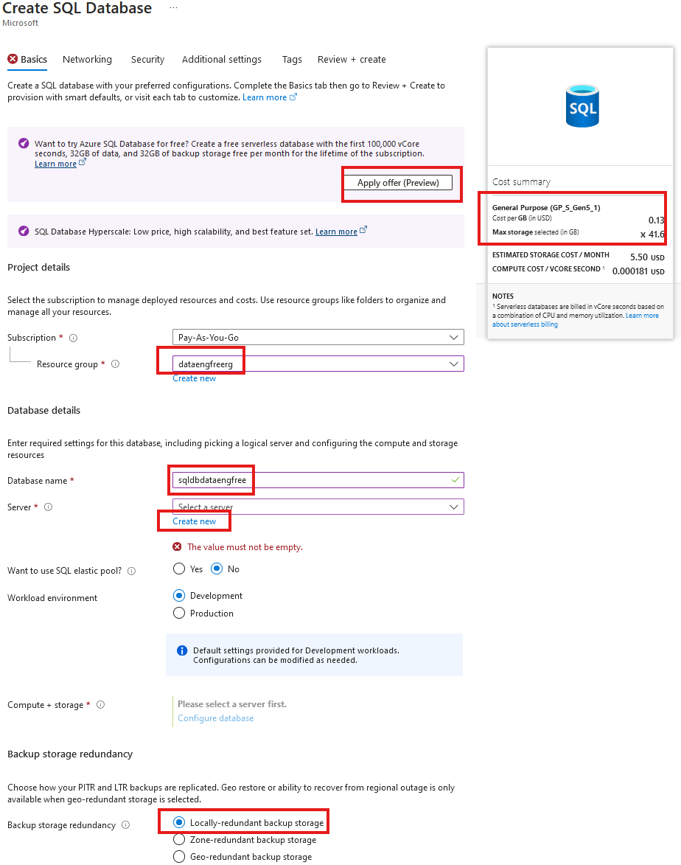
Create SQL database

Slide 15
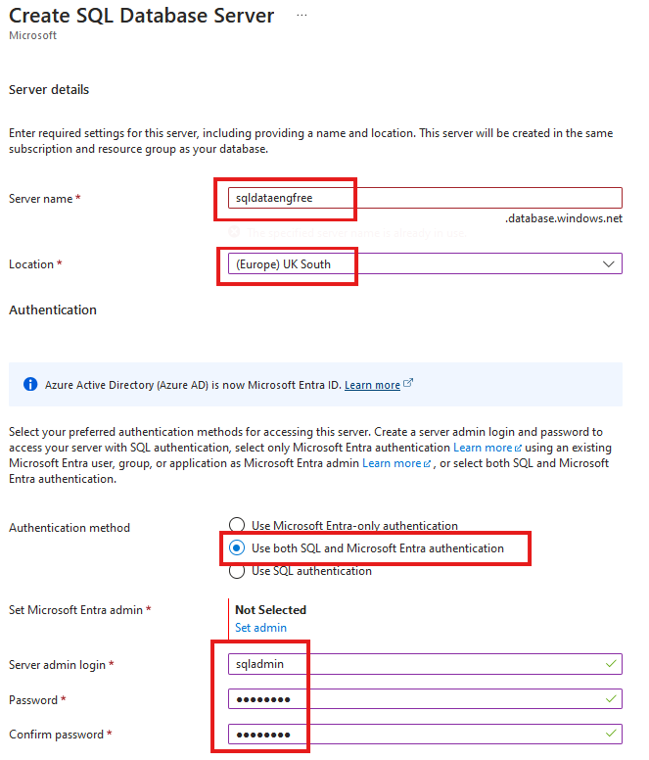
Create SQL database

Slide 16
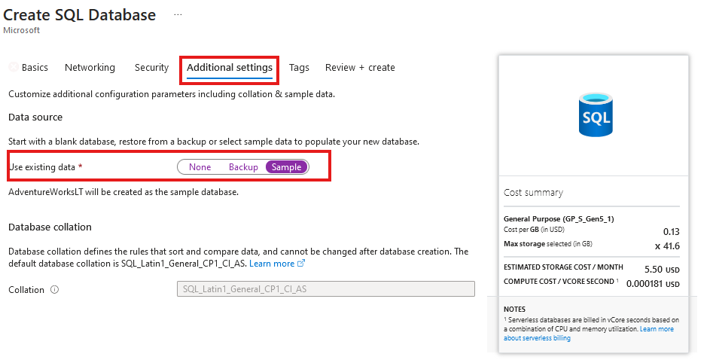
Create SQL database
Add sample data

Slide 17
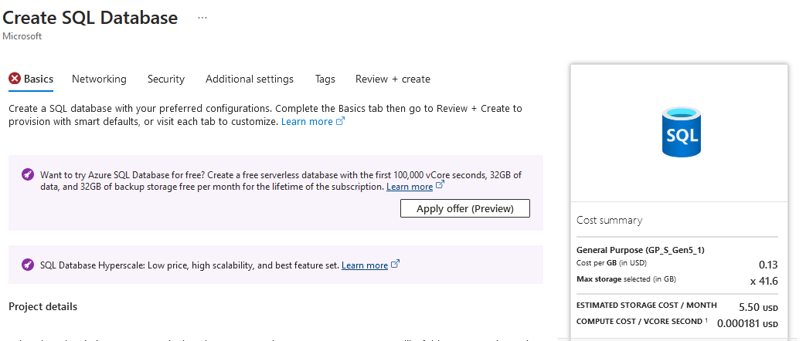

Slide 18
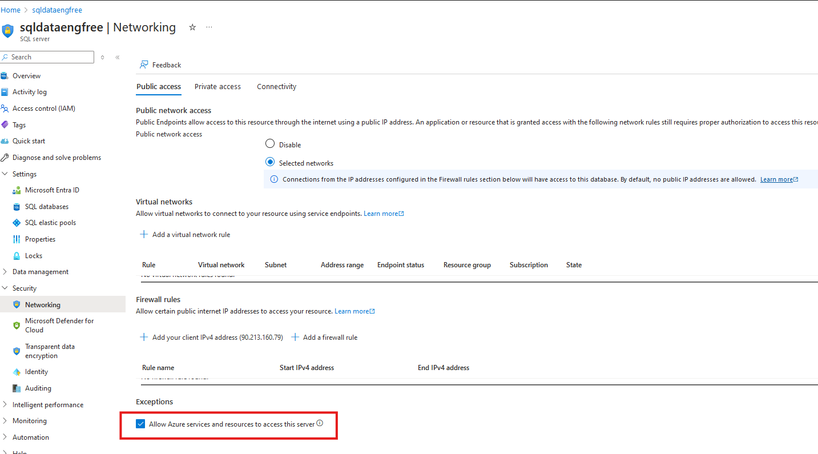

Slide 19
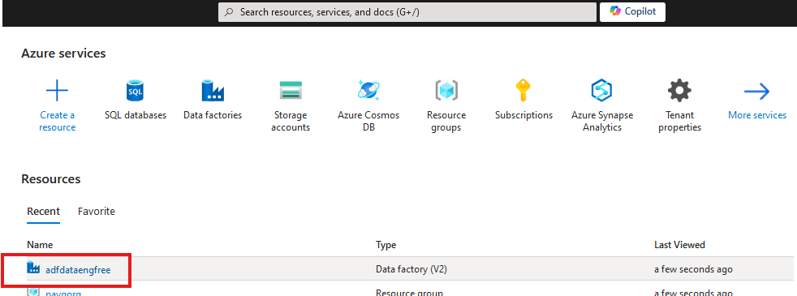
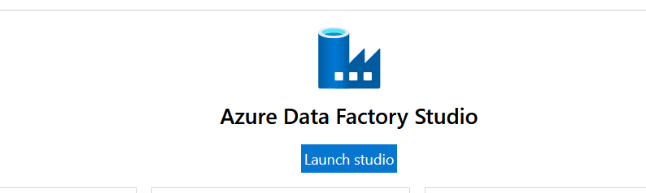

Slide 20
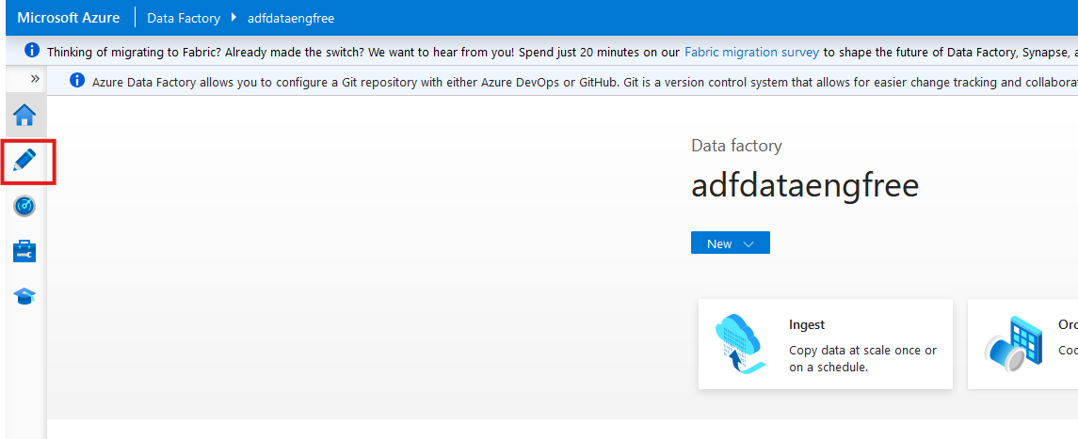

Slide 21
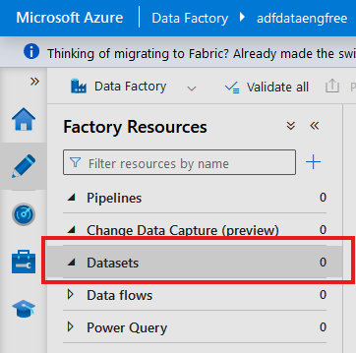
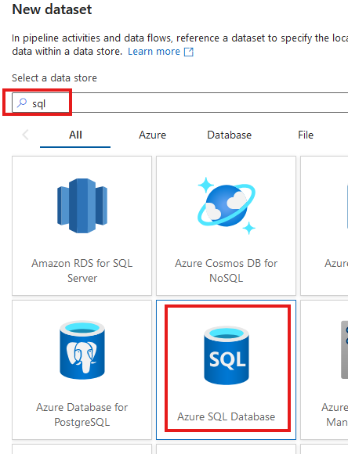

Slide 22
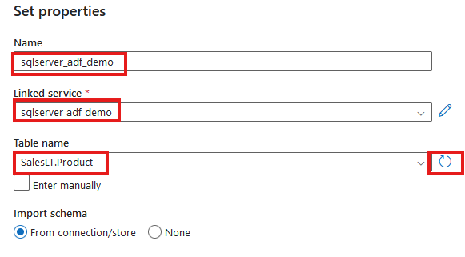

Slide 23
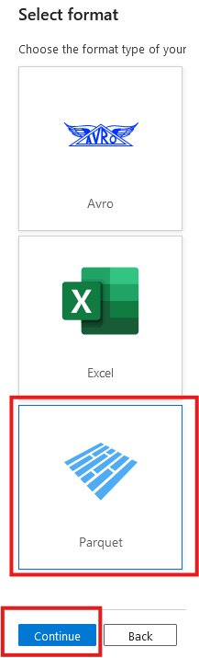
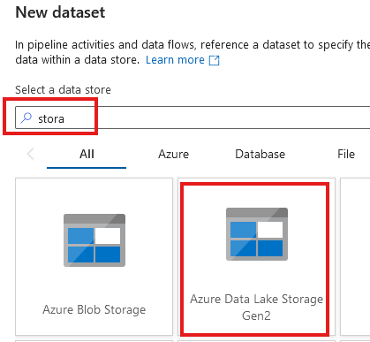

Slide 24
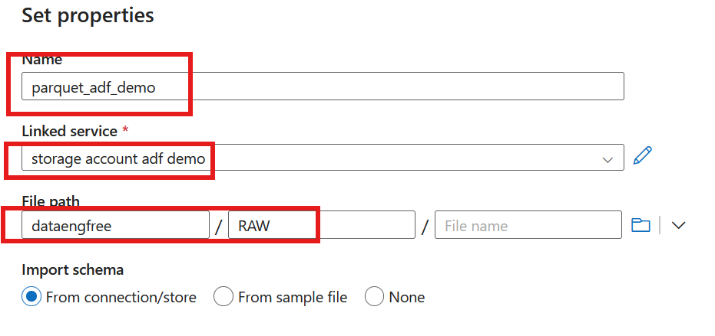

Slide 25
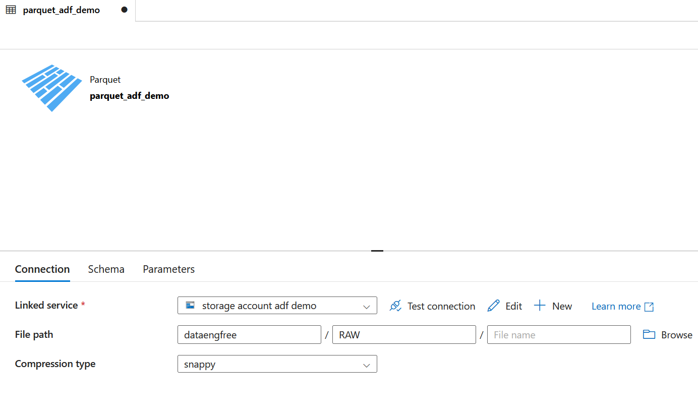

Slide 26
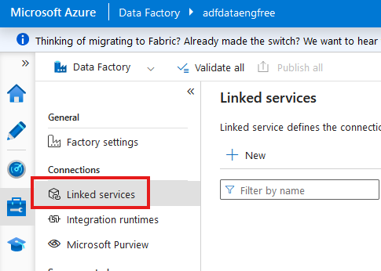

Slide 27
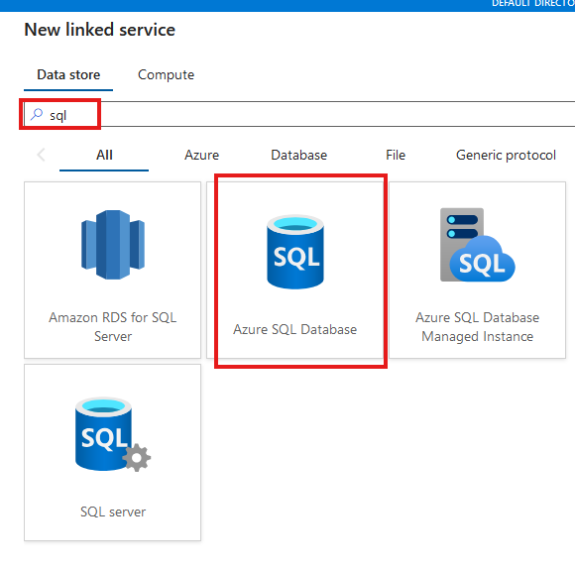

Slide 28
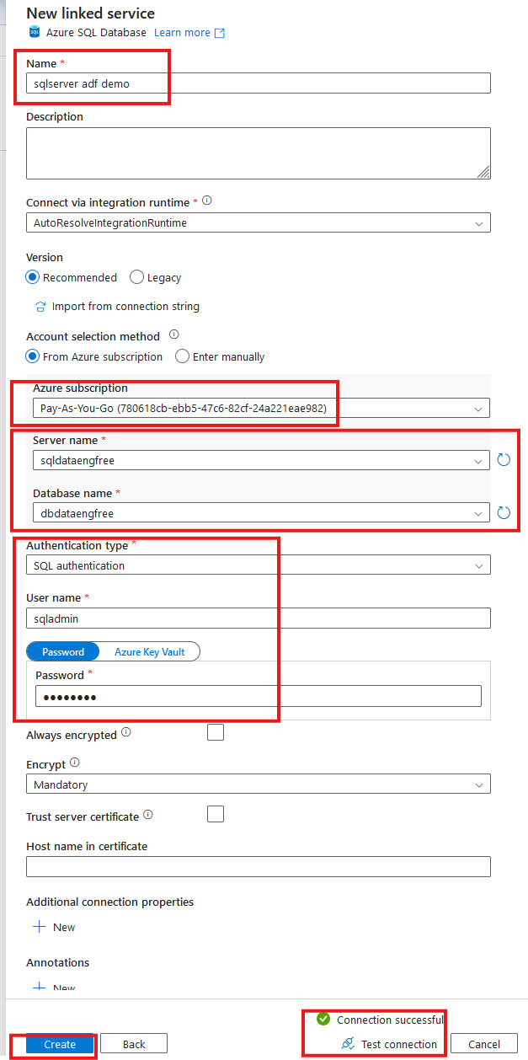

Slide 29
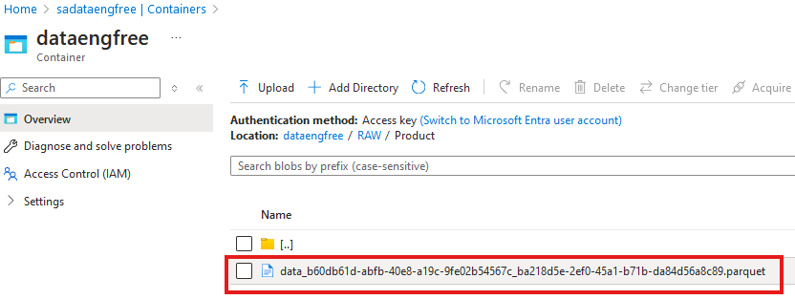

Slide 30
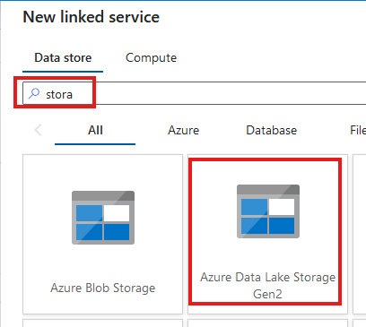
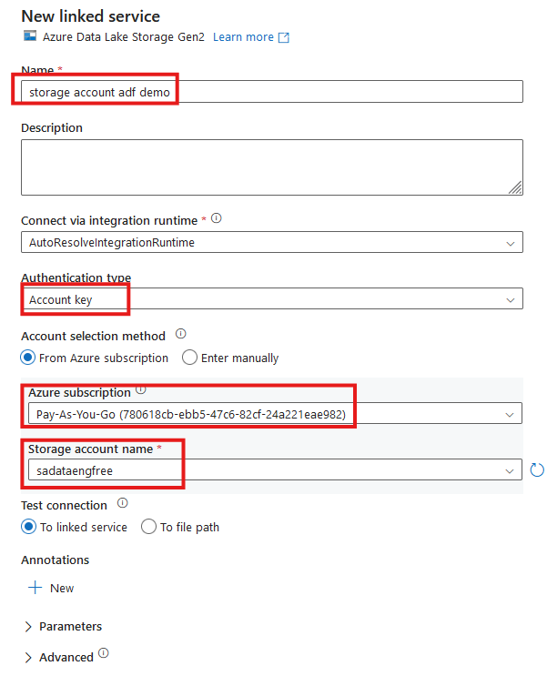


Slide 31
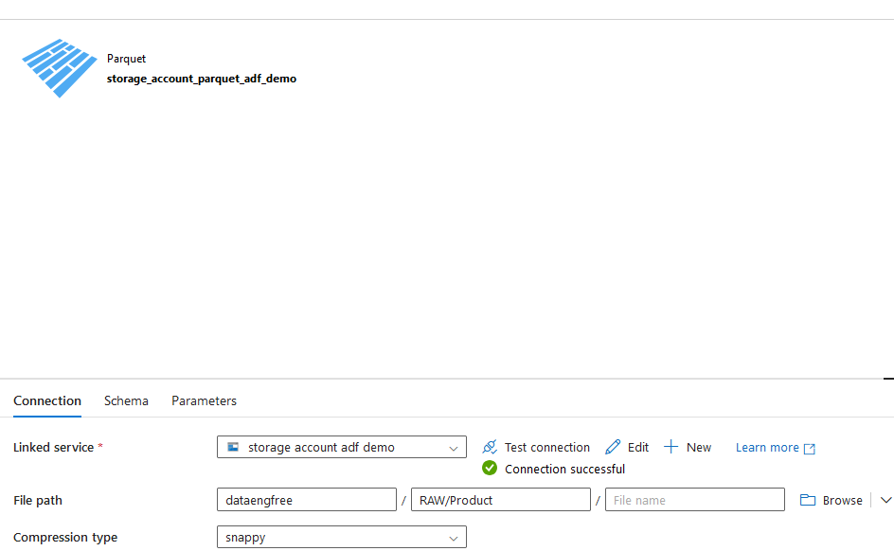

Slide 32
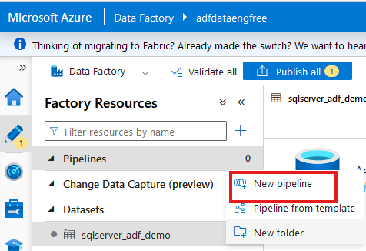
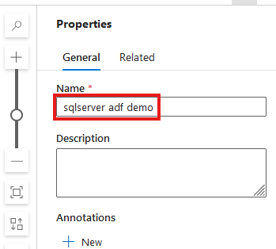

Slide 33
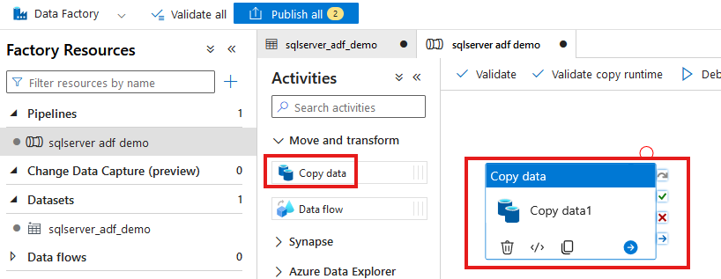

Slide 34
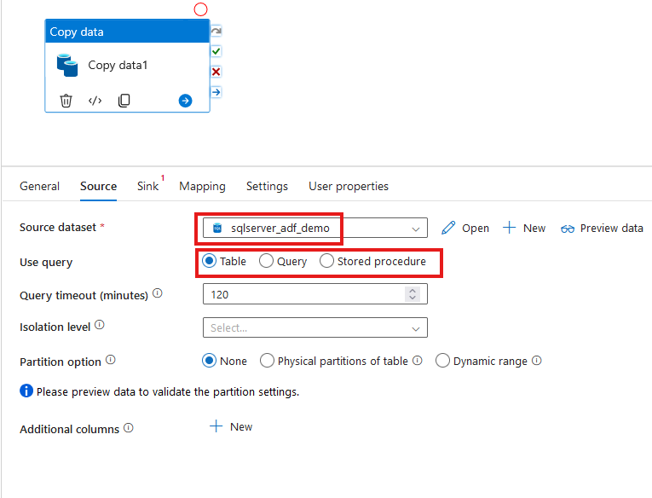

Slide 35
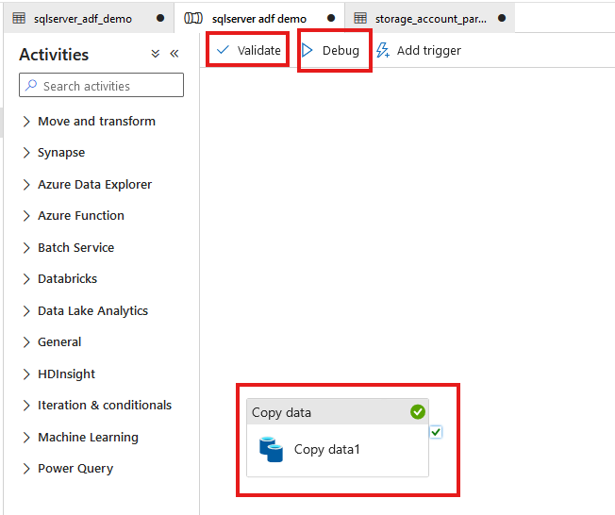

Slide 36
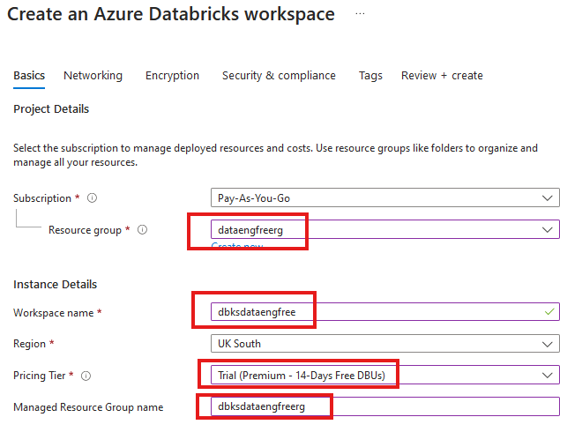


Slide 37
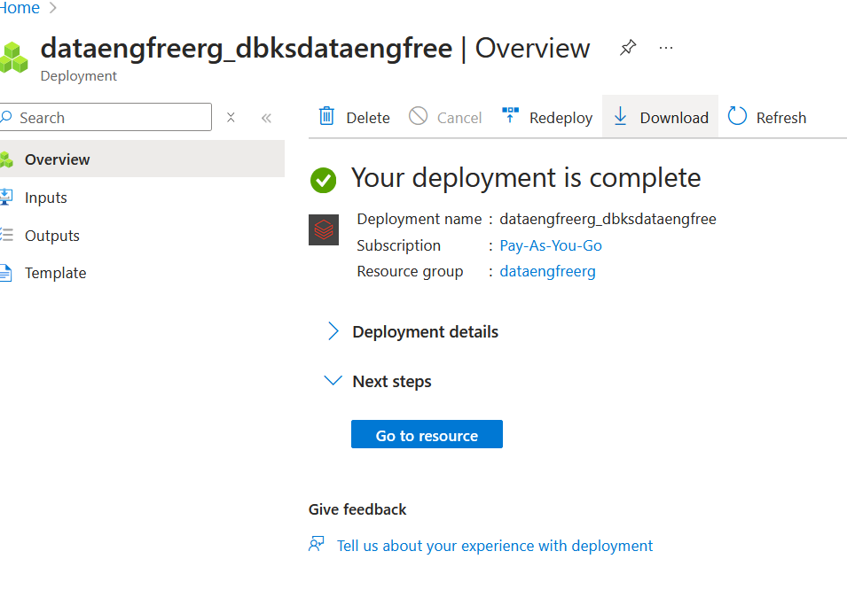

Slide 39
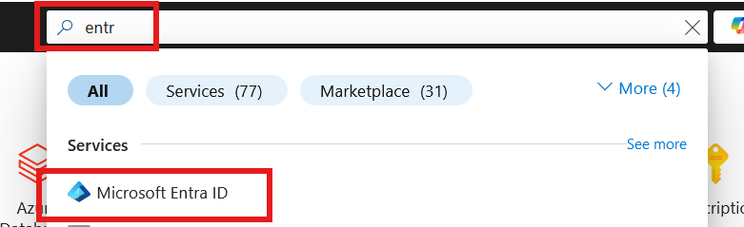
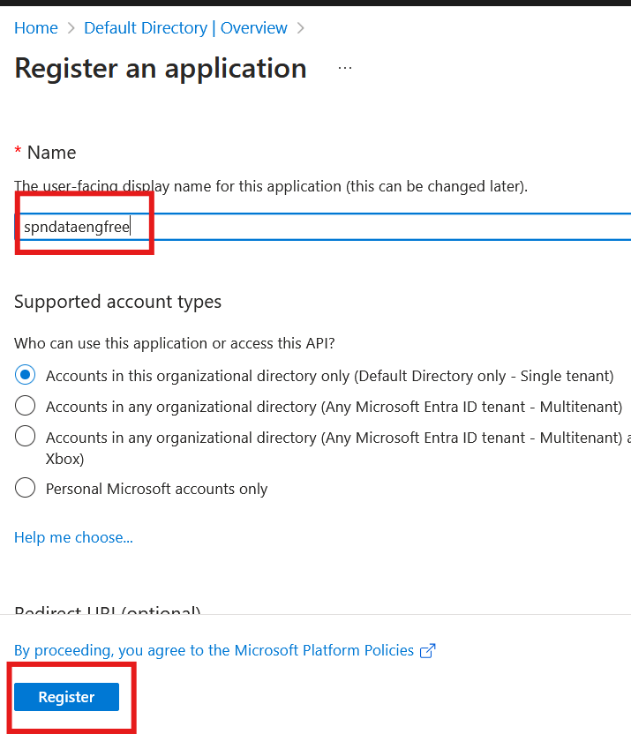

Slide 40
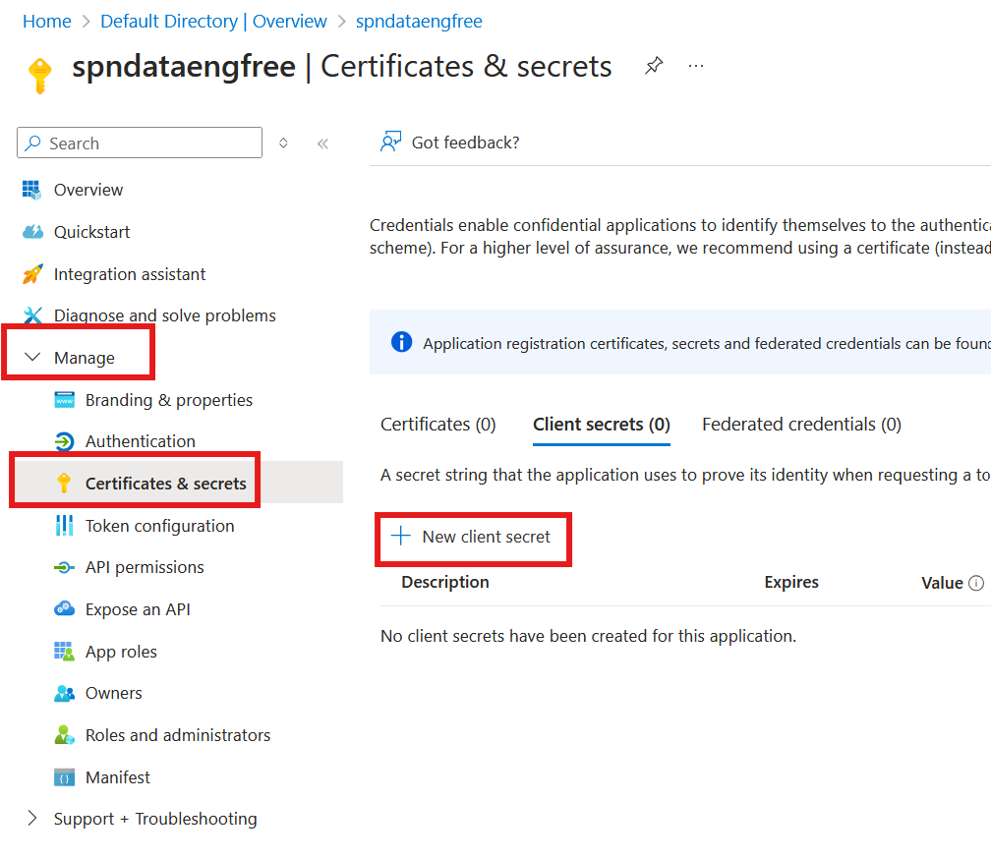
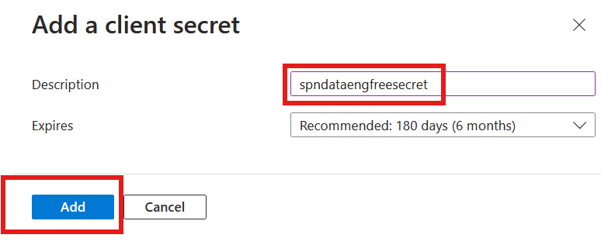

Slide 41
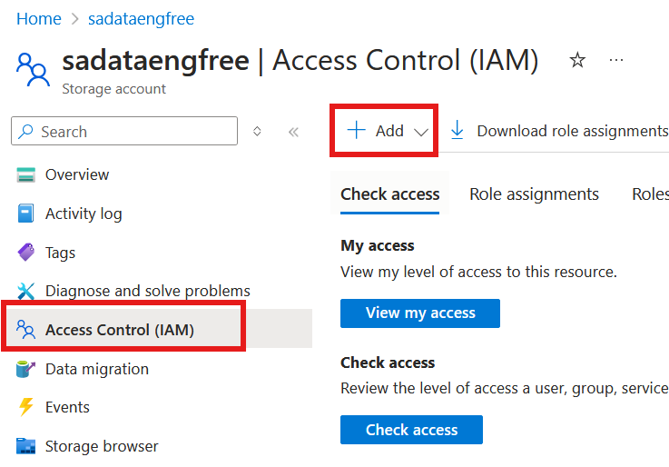
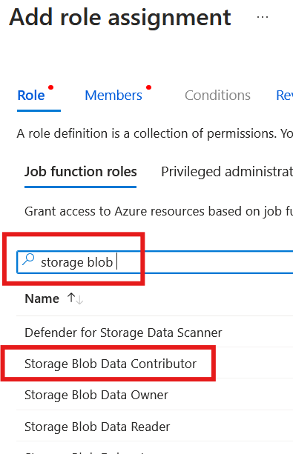

Slide 42
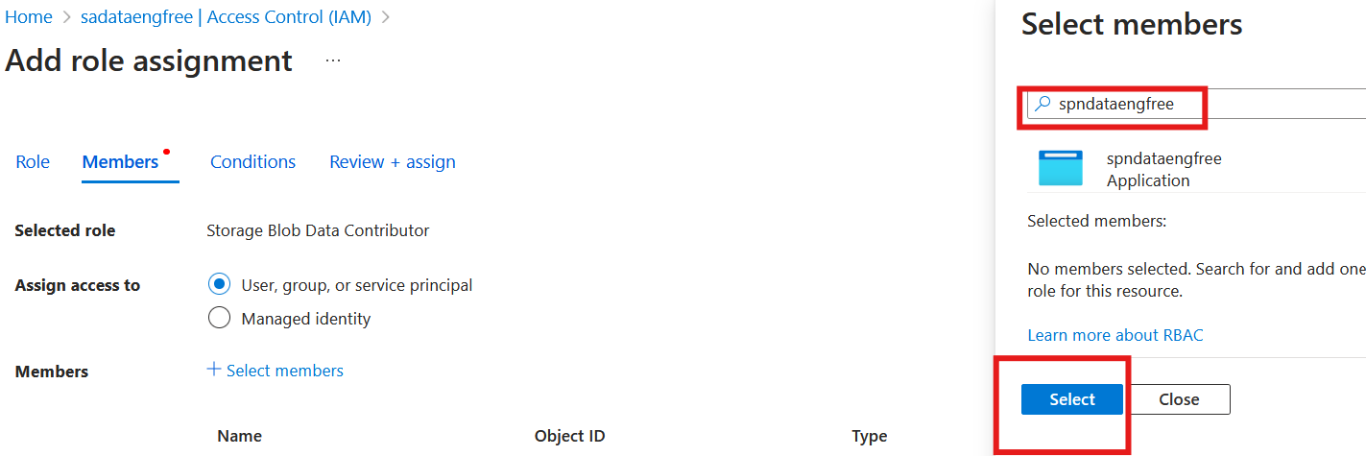

Slide 43
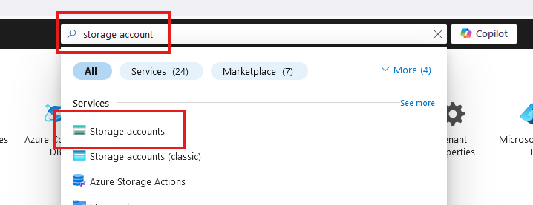
Create storage account

Slide 44
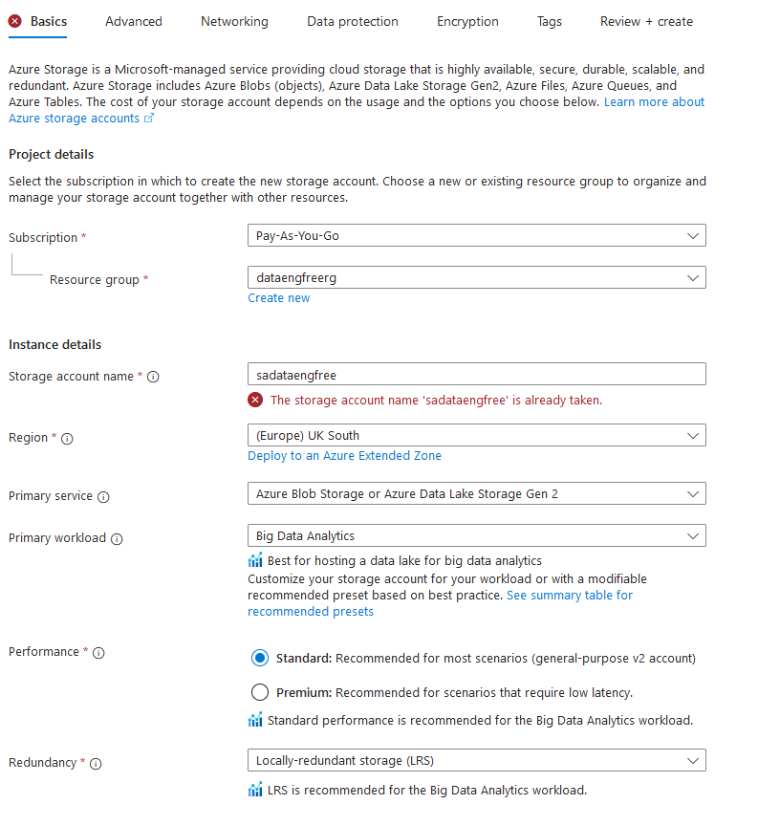
Create storage account

Slide 45
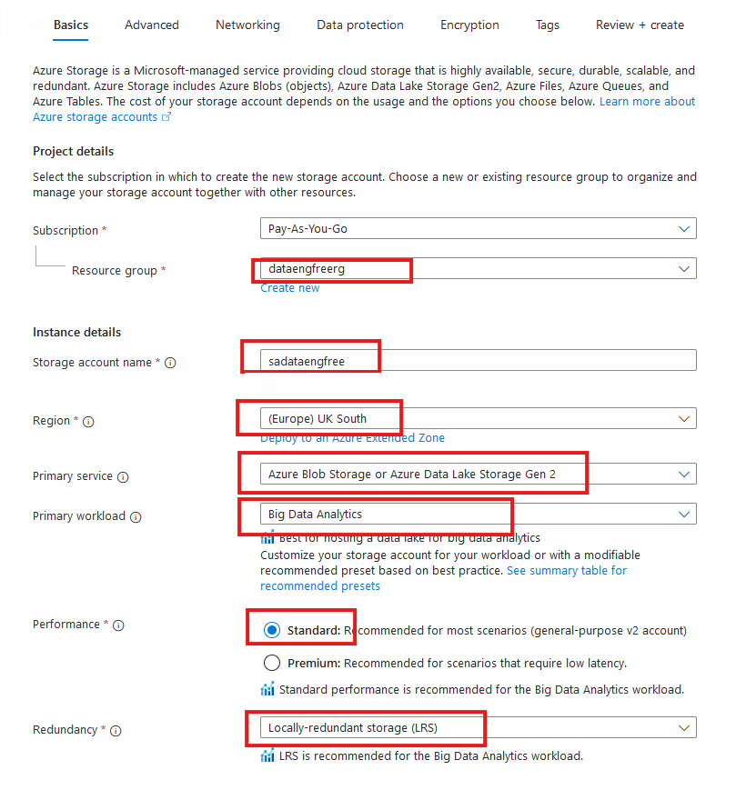
Create storage account

Slide 46
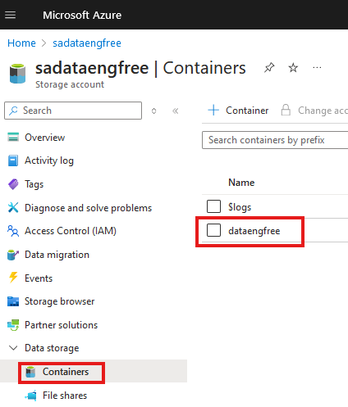
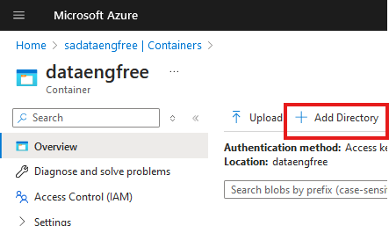

Slide 47
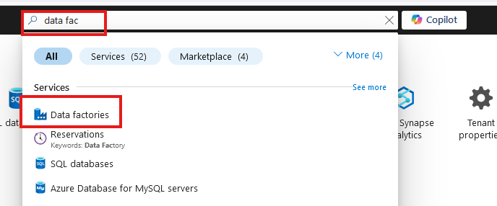
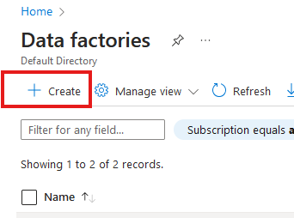
Create Azure Data Factory (ADF)

Slide 48
Create Azure Data Factory (ADF)

Slide 49

Create Azure Data Factory (ADF)

Slide 50


Slide 52


Slide 53


Slide 54
Python
Install Python
Set path
open Windows Terminal
- cd to user folder
- create folder & python file - hello-world.py
- open python file in notepad
- print('hello world')
- from terminal python hello-world.py
Run hello-world.py from VS Code in debug
Demo editing file and running in debug
Demo python from shell
Install Pip
Install Spark from Pip

Slide 55
PySpark

